Slide 1
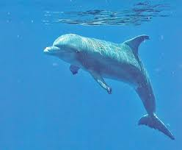
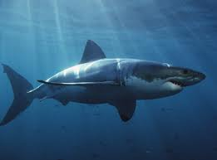
Convergent Evolution

Slide 2
Divergent Evolution

Slide 3
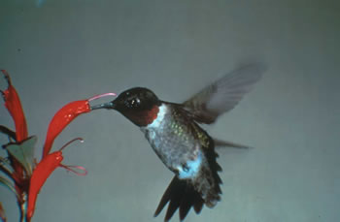
Coevolution
Ex. Long beaked Hummingbird and Red-Flowered fuschsias

Slide 4
Patterns of Evolution
Coevolution
Convergent Evolution
Divergent Evolution

