Slide 1
Change Over Time
Ms. DeLaney

Slide 2
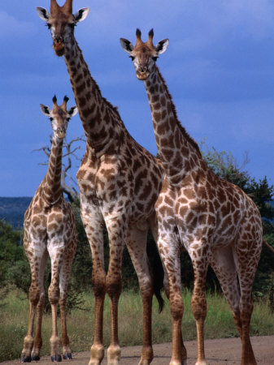
Quick Review
Species

Slide 3
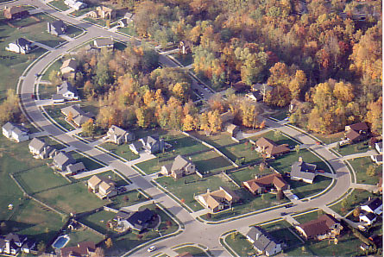
Habitat V Niche
Habitat- WHERE you live
Niche- Role you play
Notes:
Niche-smallest role of habitat. Made up of biotic and abiotic factors.

Slide 4
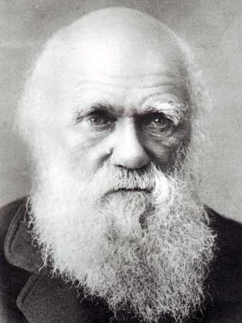
Natural Selection
Charles Darwin- WHO IS THIS GUY?!

Slide 5
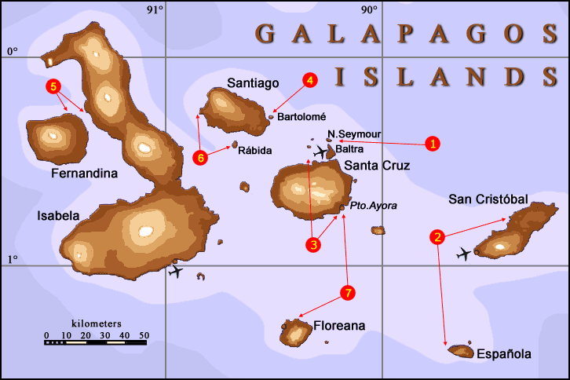
Charles Darwin
Studied organisms on the Galapagos Islands
Notes:
Notice how far apart they are– animals may have travelled between them- explain for different species?!

Slide 6
Charles Darwin
Darwin wrote: The Origin of Species which presented the idea of Natural Selection
Natural Selection?
Survival of the fittest?

Slide 7
Darwin’s finches
Darwin studied birds called finches on the Galapagos Islands:
The finches showed VARIATION in SIZE and SHAPE of beaks.
WHY????

Slide 8
Darwin’s Finches

Slide 9
Darwin’s finches
Environment change = beak change
Factors:
Varied food
Limited food (COMPETITION)
SO……..
THE PRESSUSE IS ON TO SURVIVE!
Varied beak size and shape so they could eat different foods.
EACH finch species now occupies a different niche.

Slide 10
That’s a ton of variation! Shew!

Slide 11
Another Example
Time: Industrial Revolution
How many pepper moths can you see?

Slide 13
How many moths?
Answer : 2

Slide 14
Fitness
The moths ADAPTED to turn the darker color.
This increased the moths FITNESS.
What is the fitness of a mule?

