Slide 1
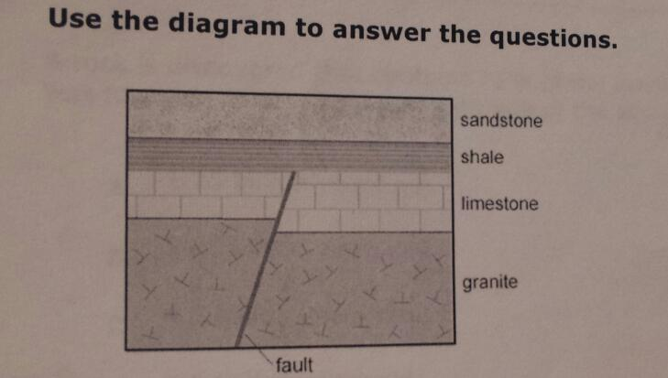
Bell Ringer 4/16/12
Write the number, underlined portion of the question, answer, and sentence justification.
What is the oldest type of rock in this formation? JUSTIFY your answer.
Which types of rock formed after the fault occurred? JUSTIFY your answer.

Slide 2
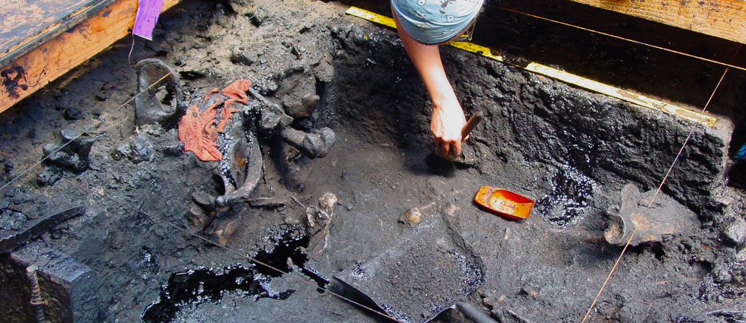
The Great Fossil Find
FOSSILS=EVIDENCE
Today, you will compare the bone structures of different species using fossils.
You will use the fossil structures to determine the ancestors of an unknown organism.
Note: Paleontologists study fossils for a variety of purposes, like establishing relative age, petroleum exploration and the study of evolution and ancient environments. Their average salary is $72,660 .
Pit 91

Slide 3
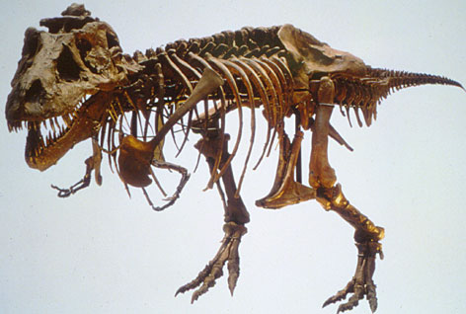
RAFTS
Role-archaeologist
Audience-tourist at a museum
Format-worksheet and poster
Topic-Fossils as Evidence
Strong Verb-Compare

