Slide 1
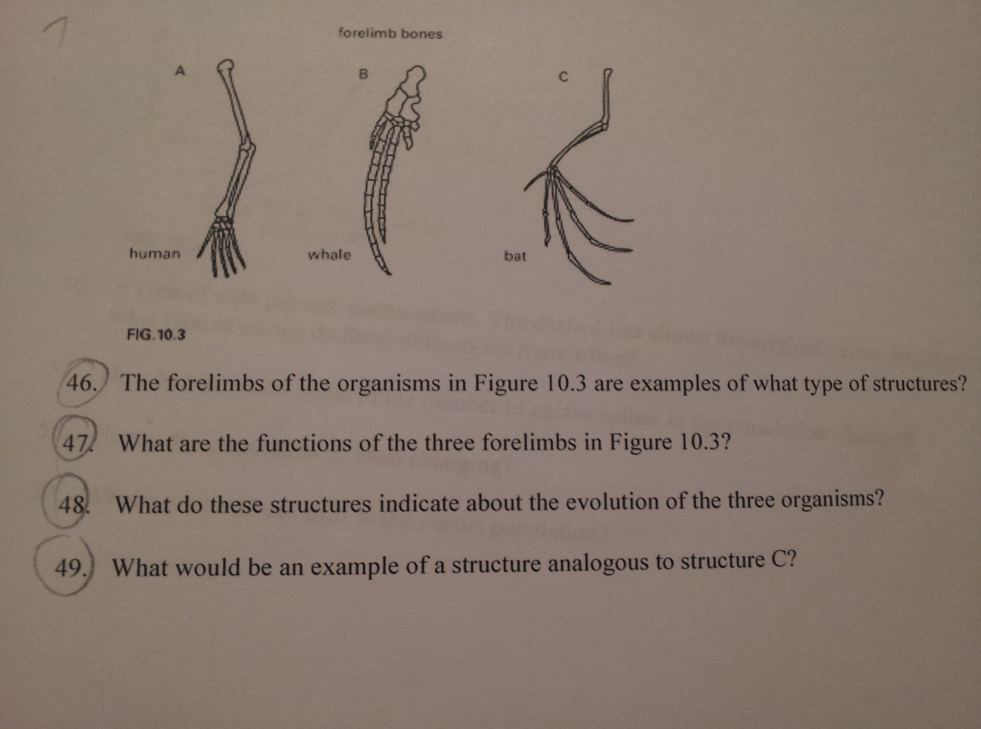
Bell Ringer 4/17
.
Answer questions 46, 47, and 48 only. Write date, # and answers

Slide 2
Homologous Structures
Structures that:
develop from a common ancestor
Are similar in shape
Differ in function
Example: human arm, bird wing, whale flipper

Slide 3
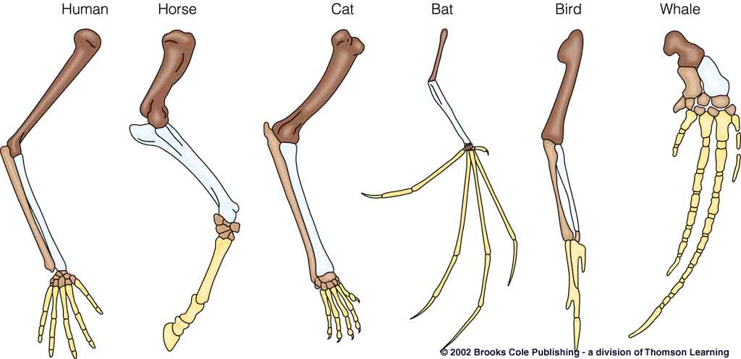
Homologous Structures
Common ancestor, same shape, different function

Slide 4
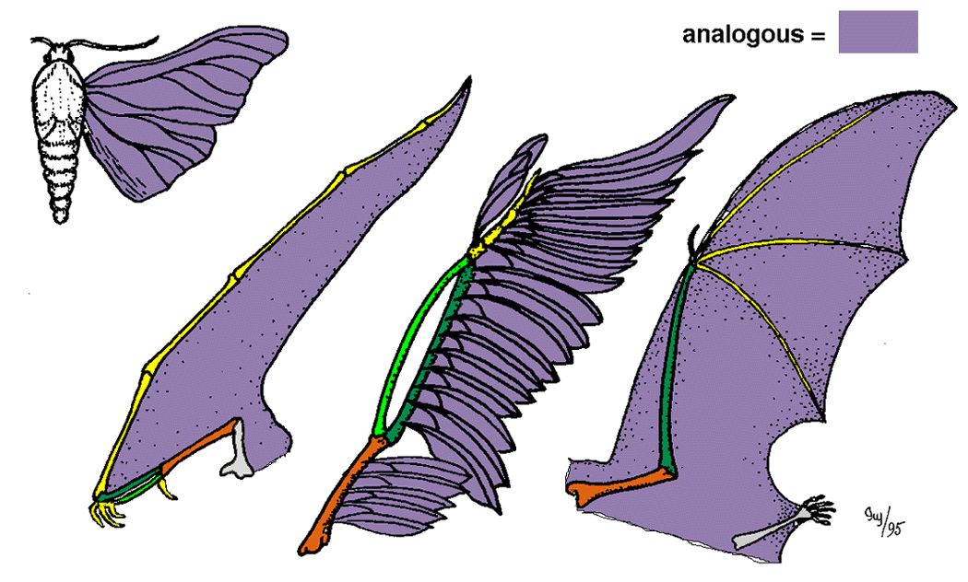
Analogous Structures
Different ancestor
Different shape
Same function
Ex:

Slide 5
Vestigial Structures
No longer in use or have greatly decreased in importance
Typically smaller than original structure
Suggest common ancestor

Slide 6
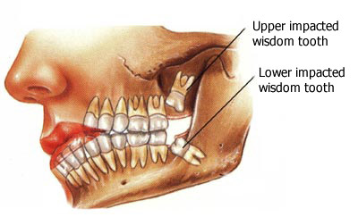
Vestigial Structures
Your grill

Slide 7
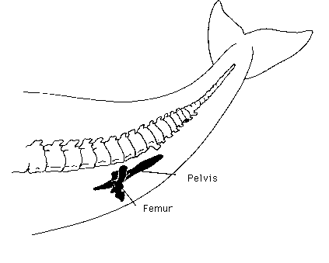
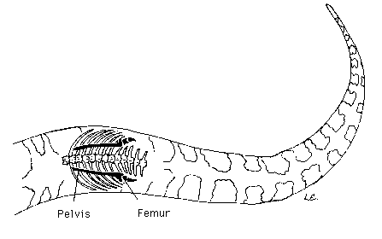
Vestigial Structures
Whale pelvis and snake pelvis

Slide 8
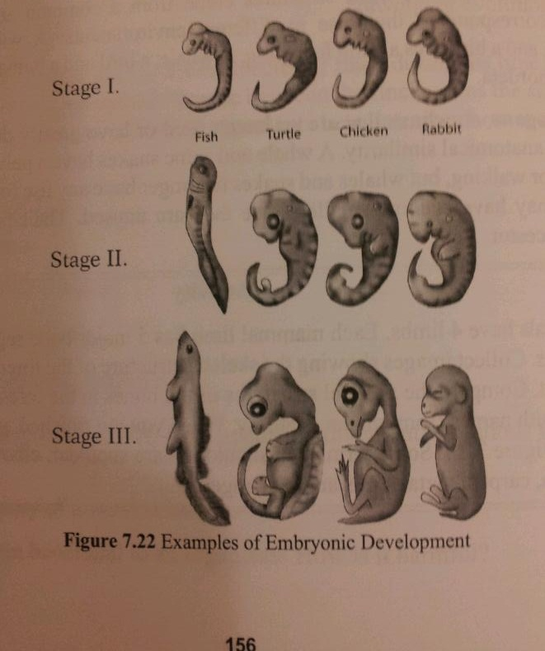
Embryology
Beginning tissues
are like the frame
of a house
All vertebrates
develop an
internal skeleton
and gill pouches

Slide 9
Embryology is an EVIDENCE of evolution.
YOUR RESPONSIBILITY FOR TODAY:
OBJECTIVE: You will COMPARE embryos in order to determine which embryos are most likely descended from a common ancestor.

